Slide 1

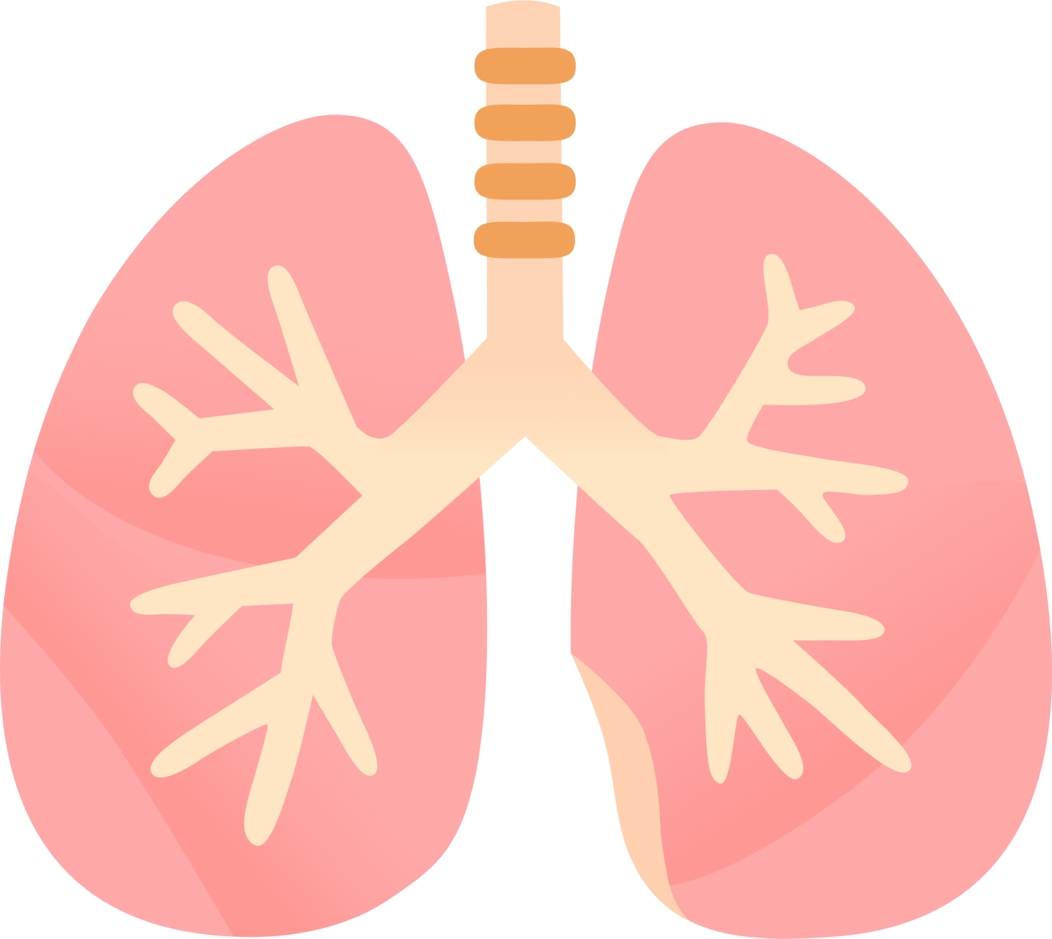
LUNG SOUND RECORDER
Team: Quad-Core Squad
By: Karthik, Aryanil, Anurag, and Adithya
Professor: Abhishek Srivastava
TA: Santhoshini
Week-4

Slide 2
Modeling silicone tube

Slide 3
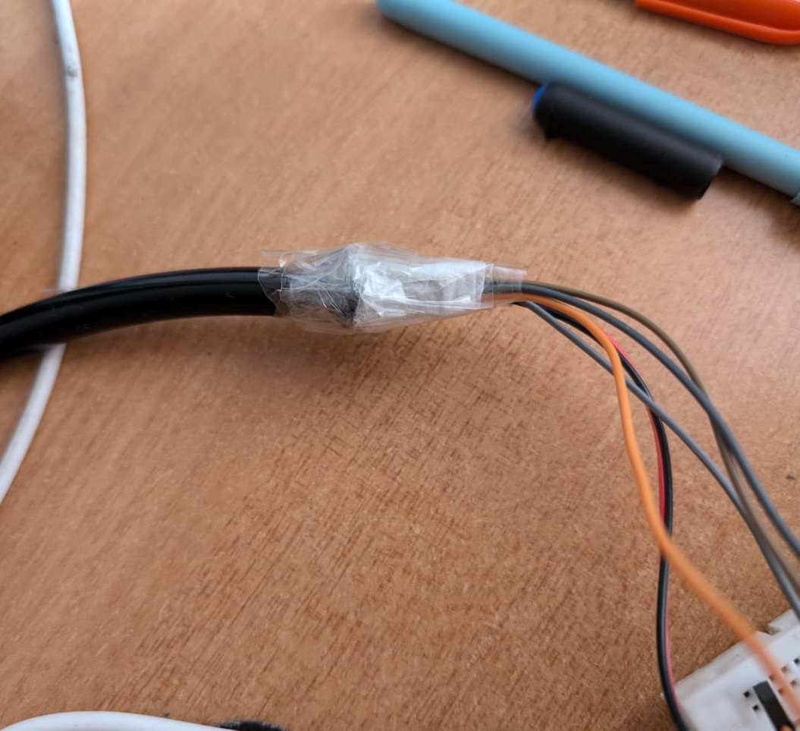
Idea
Stethoscope
Silicone tube
Our plan is to 3D print a silicone tube to put around the stethoscope-INMP junction to isolate as much noise as possible and create a kind of seal.
Silicone is a good choice due to its soundproofing properties.
Wires connecting INMP to ESP

Slide 4
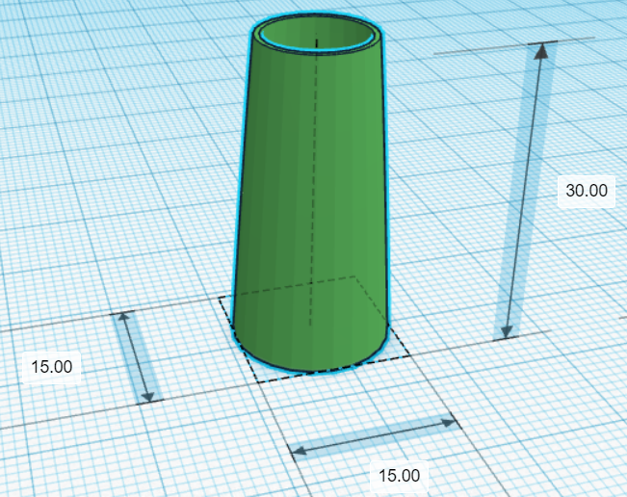
First model
This model is a simple paraboloid
It has two ends, one for the stethoscope and one for the INMP441
The stethoscope end has a diameter of 11 mm, while the INMP end has a diameter of 15 mm

Slide 5
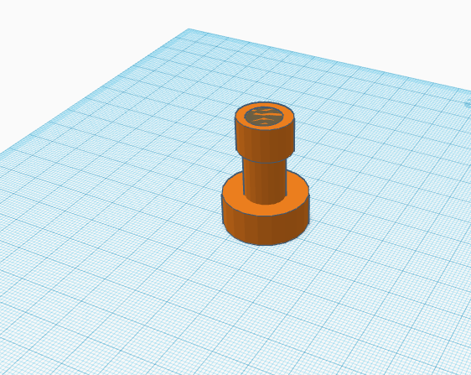
Second model
This model utilises a unique cylindrical design.
The idea is that it aligns the sound along a narrow pathway, preserving intensity and clarity.
There is a hole through which sound and easily pass through.

Slide 6
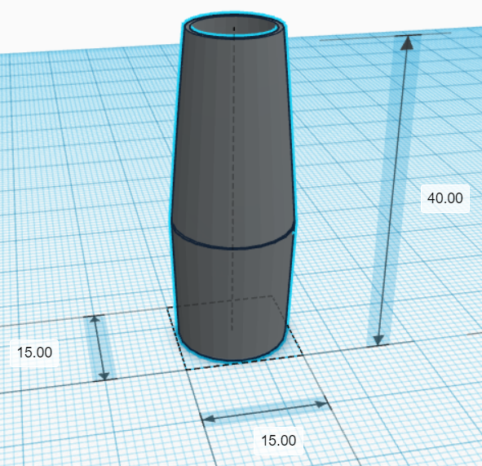
Third model
This model modifies and adds on to the first model
Now both ends of the tube taper a bit, instead of only one end like the first model
This was so that the INMP could fit snugly into the tube and be secured if required.
Now the stethoscope end is 11 mm in diameter and the INMP end is 14 mm

Slide 7
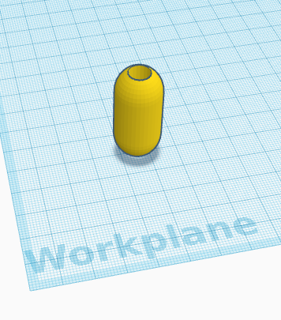
Fourth model
This model has curved ends that can help it wedge between the tubes.
It can help reduce noise by giving a tighter fit

Slide 8
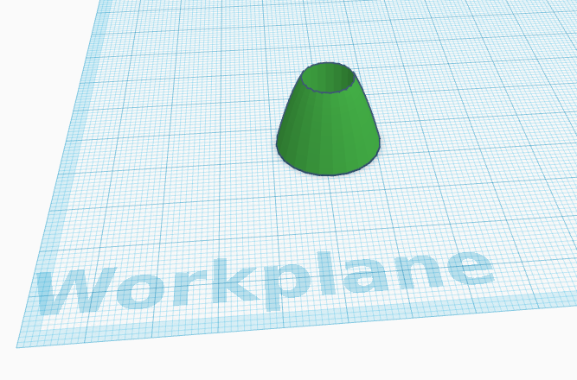
Fifth model
This model dramatically reduces the distance between mic and tube.
It can boost clarity by reducing iterference from other sources.

Slide 9
Filtering on ESP32
Tried to implement a first order IIR filter directly on the ESP32.
Code needs improvement, output is still noisy
Code can be found at https://github.com/AryanilPanja/lung_sound_recorder/blob/main/ESP_codes/mic_record_lowpass.ino

Slide 10
Why can't we process wavelet transform on ESP?
Due to its low memory constraint, and very low processing it becomes almost impossible i.e: putting python libraries on the Microcontroller and performing fast processing.
We could be using Nvidia Jetson or R-Pi for processing
just before running the classification models.

Slide 11
Using CNN for Image Classification with MobileNet Architecture

Slide 12
Why CNN & MobileNet?
CNNs excel at image classification by learning spatial patterns.
MobileNet offers a lightweight, efficient architecture ideal for resource-constrained environments.
Pre-trained on ImageNet: Faster training, better accuracy with limited data.

Slide 13
Data Preprocessing – Generating Spectrograms
Spectrogram Generation:
We are converting audio signals into images (frequency over time) which the CNN can process.
STFT (Short-Time Fourier Transform): Used to create spectrograms from audio.
Librosa Library: Handles the audio conversion process.
Mel-Spectrogram: Focuses on frequency bands most relevant to human perception.

Slide 14
Data Preprocessing – Generating Spectrograms
Steps for Preprocessing:
Load audio files.
Convert each audio file into a spectrogram image.
Resize spectrograms to fit the model input size (224x224 for MobileNet).
ImageDataBunch:
After generating spectrograms, FastAI’s ImageDataBunch is used to load and normalize them for training.

Slide 15
Model Creation – Transfer Learning with MobileNet
What is Transfer Learning?
A technique where a pre-trained model is adapted to a new but related task.
Utilizes the knowledge gained from a large dataset (e.g., ImageNet) to improve performance on smaller datasets.
Why Use MobileNet?
Lightweight and efficient architecture suitable for devices with limited computational power.
Pre-trained on ImageNet, enabling it to recognize general features effectively.

Slide 16
Results & Model Saving
Confusion Matrix: A table used to evaluate the performance of a classification algorithm
Save the Model: For future use or deployment using FastAI’s export and save functions.

Slide 17
References
https://www.kaggle.com/code/arbazkhan971/image-classifications-in-5-steps-for-beginner
https://ieeexplore.ieee.org/document/10509905

Slide 18
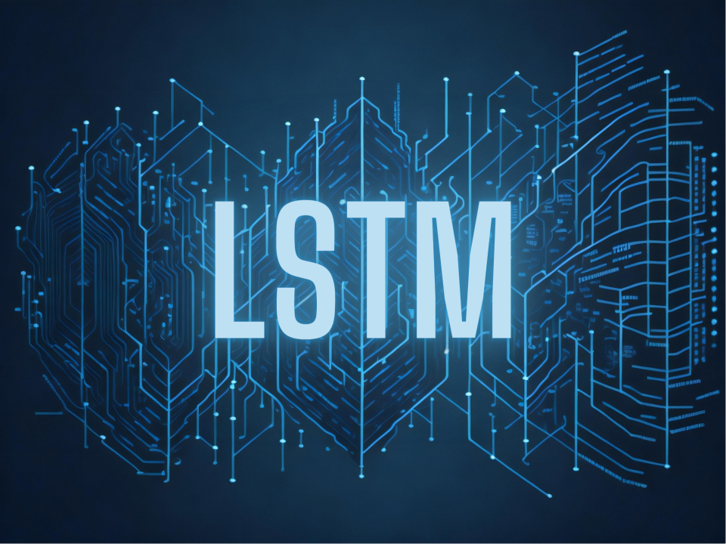
Recurrent Neural Networks (RNNs), Long Short-Term Memory (LSTM),

Slide 19
Why RNN's or LSTM
Lung and heart sounds are time-series data, which means there is a temporal dependency between successive samples. RNNs, LSTMs, and GRUs are designed to capture and learn from such sequences of data.

Slide 20
Sequential Data Processing
The key feature of RNNs is their ability to process sequences of data by maintaining a "hidden state" (a kind of memory) that captures information about previous steps. This is essential for tasks where the order of inputs matters—like analyzing sounds, sentences, or stock prices.

Slide 21
Input: The input to an RNN is a sequence of data points. For example, in the context of heart or lung sound analysis, each data point might represent a set of features (e.g., MFCCs) extracted from small windows of an audio file over time.

Slide 22
Hidden State: At each time step, the RNN maintains a hidden state that acts as a memory. The hidden state is updated with each new data point in the sequence, meaning it "remembers" the previous inputs and incorporates them into its understanding of the current data point.

Slide 23
Output: At each time step, the RNN produces an output based on the current input and the hidden state. This output can be used for predictions at each time step (e.g., classifying a sound segment as normal or abnormal), or you can wait until the end of the sequence for a final decision.

Slide 24
LSTM vs RNN
The base underlying functionality of LSTM is basically RNN but the model is designed in a specific way such that the Hidden state memory takes account for much longer periods of data rather than a short period.
So ,LSTM model is told to tackle the Vanishing Gradient Problem.

Slide 25
References:
Mdpi research paper
-It talks about how different Data Classification Models can be used for classification and what advantages one have over another.

Slide 26
Next steps
3D printing the tube to isolate the noise
Trying different types of tapes to secure the wires
Implementing a CNN model and other models to classify the sound
Try connecting INMP directly to ESP32

